Slide 1


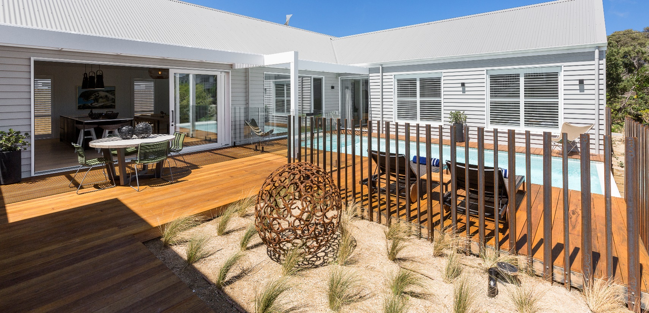


Design Innovation Quality Performance
FULL RANGE OF ALUMINIUM AND TIMBER WINDOWS AND DOORS
A complete solution to builders for your aluminium and timber window and door needs, standard or custom made, for every style of home from value residential to high end architectural.
FEATURING
Four species of timber
3 specific ranges of aluminium product to meet design and budget needs
Exclusive timber clear seal protectant to reduce timber maintenance
Click to start

Slide 2

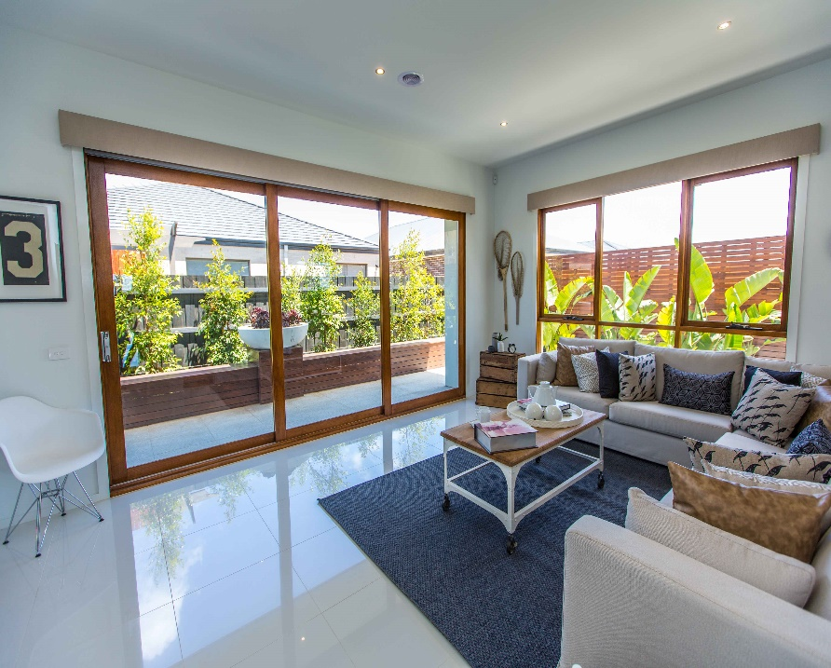
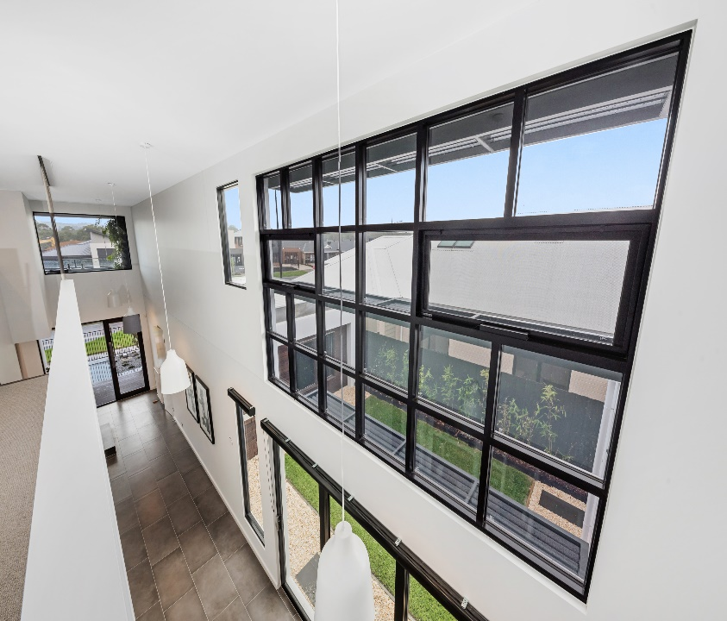

Design Innovation Quality Performance
🏠
TIMBER
DOORS
TIMBER WINDOWS
TIMGUARD
TIMBER SPECIES
ALUMINIUM
WINDOWS
ALUMINIUM
DOORS
ALUMINIUM RANGES
TEXTURA
POWDER COAT
ALUMINIUM
COLOURS
ENERGY RATINGS
ORDER
PROCESS
MYTHS ABOUT CHOOSING TIMBER
100 SERIES VALUE RESIDENTIAL
200 SERIES
IMPROVED PERFORMANCE
300 SERIES
HIGH END ARCHITECTURAL
TECHNICAL SUPPORT

Slide 3

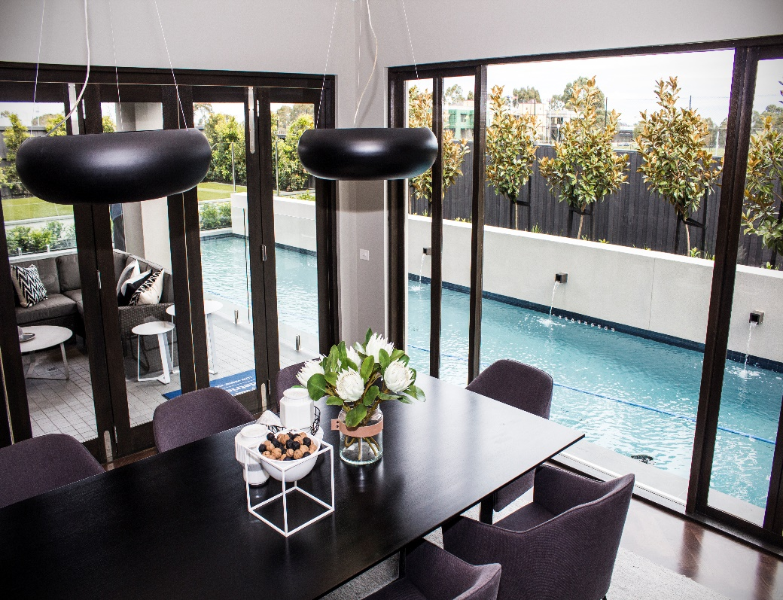

Design Innovation Quality Performance
🏠
TIMBER
DOORS
TIMBER WINDOWS
TIMGUARD
TIMBER SPECIES
ALUMINIUM
WINDOWS
ALUMINIUM
DOORS
ALUMINIUM RANGES
TEXTURA
POWDER COAT
ALUMINIUM
COLOURS
ENERGY RATINGS
ORDER
PROCESS
MYTHS ABOUT CHOOSING TIMBER
100 SERIES VALUE RESIDENTIAL
200 SERIES
IMPROVED PERFORMANCE
300 SERIES
HIGH END ARCHITECTURAL
TECHNICAL SUPPORT
Timber Door Range
Sliding Doors
Stacking Sliding Doors
Bifold Doors
French Doors

Slide 4
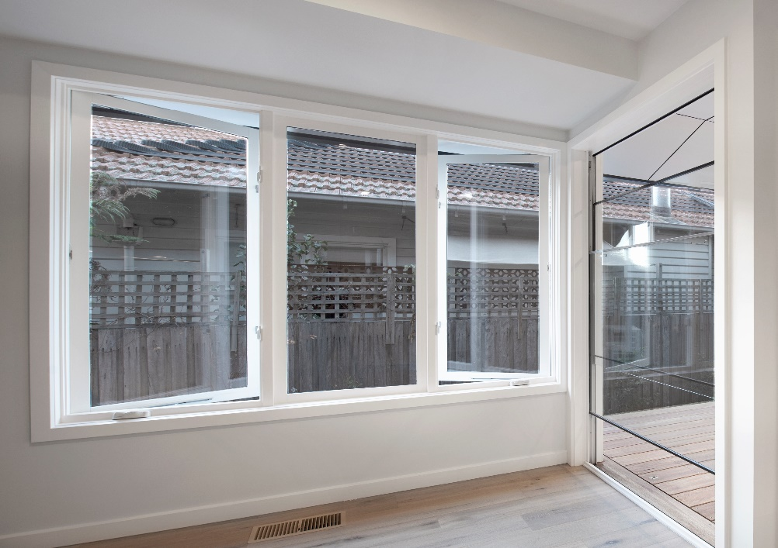
Design Innovation Quality Performance
🏠
TIMBER
DOORS
TIMBER WINDOWS
TIMGUARD
TIMBER SPECIES
ALUMINIUM
WINDOWS
ALUMINIUM
DOORS
ALUMINIUM RANGES
TEXTURA
POWDER COAT
ALUMINIUM
COLOURS
ENERGY RATINGS
ORDER
PROCESS
MYTHS ABOUT CHOOSING TIMBER
100 SERIES VALUE RESIDENTIAL
200 SERIES
IMPROVED PERFORMANCE
300 SERIES
HIGH END ARCHITECTURAL
TECHNICAL SUPPORT
Timber Window Range
Sliding Windows
Awning Windows
Double Hung Windows
Casement Windows
Bifold Windows
Louvre Windows
Sashless Double Hung Windows

Slide 5

Design Innovation Quality Performance
🏠
TIMBER
DOORS
TIMBER WINDOWS
TIMGUARD
TIMBER SPECIES
ALUMINIUM
WINDOWS
ALUMINIUM
DOORS
ALUMINIUM RANGES
TEXTURA
POWDER COAT
ALUMINIUM
COLOURS
ENERGY RATINGS
ORDER
PROCESS
MYTHS ABOUT CHOOSING TIMBER
100 SERIES VALUE RESIDENTIAL
200 SERIES
IMPROVED PERFORMANCE
300 SERIES
HIGH END ARCHITECTURAL
TECHNICAL SUPPORT
EXCLUSIVE two coat clear seal applied in the factory prior to delivery

Slide 6
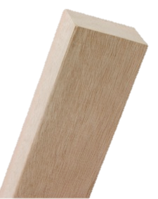
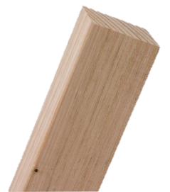
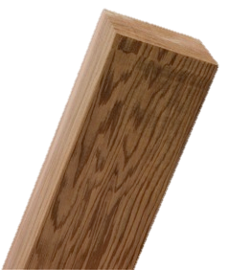


Design Innovation Quality Performance
TIMBER
DOORS
TIMBER WINDOWS
TIMGUARD
TIMBER SPECIES
ALUMINIUM
WINDOWS
ALUMINIUM
DOORS
ALUMINIUM RANGES
TEXTURA
POWDER COAT
ALUMINIUM
COLOURS
ENERGY RATINGS
ORDER
PROCESS
🏠
MYTHS ABOUT CHOOSING TIMBER
100 SERIES VALUE RESIDENTIAL
200 SERIES
IMPROVED PERFORMANCE
300 SERIES
HIGH END ARCHITECTURAL
TECHNICAL SUPPORT
Four species of timber available for all timber products, with our exclusive two coat clear seal for added protection
Meranti
KDHW
Western Red Cedar
Merbau is also available to meet BAL 29 if required

Slide 7







Design Innovation Quality Performance
🏠
TIMBER
DOORS
TIMBER WINDOWS
TIMGUARD
TIMBER SPECIES
ALUMINIUM
WINDOWS
ALUMINIUM
DOORS
ALUMINIUM RANGES
TEXTURA
POWDER COAT
ALUMINIUM
COLOURS
ENERGY RATINGS
ORDER
PROCESS
MYTHS ABOUT CHOOSING TIMBER
100 SERIES VALUE RESIDENTIAL
200 SERIES
IMPROVED PERFORMANCE
300 SERIES
HIGH END ARCHITECTURAL
TECHNICAL SUPPORT
Timber windows need to be maintained to protect the wood. They can rot if left untreated
Timber windows are more susceptible to the outside environment, such as the weather which makes them hard to maintain
Exclusive to Canterbury windows and doors
2 coat clear seal
25% greater and more consistent film build
Protection for all sides of windows and doors – inside and out
Minimises moisture variation and timber movement
Provides an undercoat that can be stained and painted over
.
Click for more myths

Slide 8




Design Innovation Quality Performance
🏠
🏠
TIMBER
DOORS
TIMBER WINDOWS
TIMGUARD
TIMBER SPECIES
ALUMINIUM
WINDOWS
ALUMINIUM
DOORS
ALUMINIUM RANGES
TEXTURA
POWDER COAT
ALUMINIUM
COLOURS
ENERGY RATINGS
ORDER
PROCESS
MYTHS ABOUT CHOOSING TIMBER
100 SERIES VALUE RESIDENTIAL
200 SERIES
IMPROVED PERFORMANCE
300 SERIES
HIGH END ARCHITECTURAL
TECHNICAL SUPPORT
Timber windows are vulnerable to insects, for example termites
Timber Windows Are More Expensive Than Other Options Such As Aluminium
Our Meranti timber window and door range are treated with Protim® .
All Timber window and door products are warranted against attack for 7 years.
Improved Energy Performance
Superior acoustic performance
Improved resale values
Lower maintenance costs using TimGuard

Slide 9
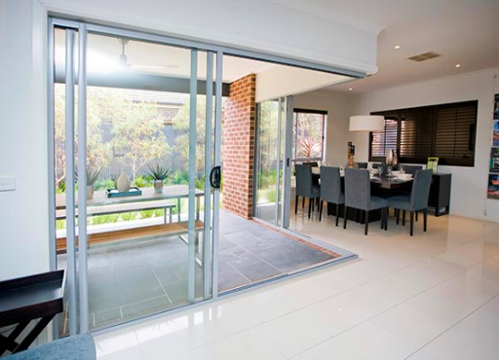
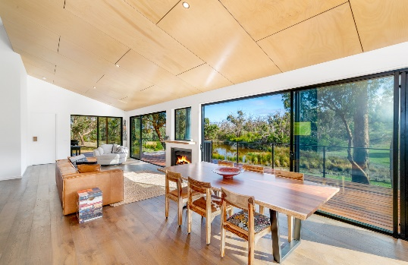
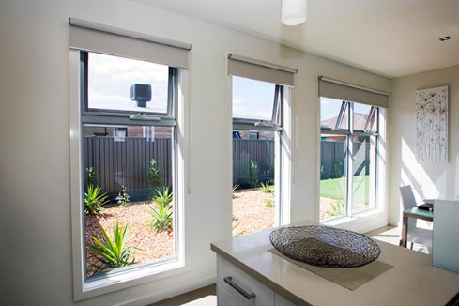

Design Innovation Quality Performance
🏠
TIMBER
DOORS
TIMBER WINDOWS
TIMGUARD
TIMBER SPECIES
ALUMINIUM
WINDOWS
ALUMINIUM
DOORS
ALUMINIUM RANGES
TEXTURA
POWDER COAT
ALUMINIUM
COLOURS
ENERGY RATINGS
ORDER
PROCESS
MYTHS ABOUT CHOOSING TIMBER
100 SERIES VALUE RESIDENTIAL
200 SERIES
IMPROVED PERFORMANCE
300 SERIES
HIGH END ARCHITECTURAL
TECHNICAL SUPPORT
Value Residential
Improved
Performance
High End
Architectural
The 100 Series
Outstanding style and quality
Affordable value for residential housing and low-rise units.
Can also have a place in architectural and custom design homes
The 200 Series
Designer range
Performance and aesthetic appeal
Stylish and versatile.
Provides a variety of glazing options to ensure comfort, energy efficiency and performance
Impressive semi architectural look at affordable price
The 300 Series
A premium range
Sophisticated architectural design
Superior quality, functionality, style and value.
Designed for specialized residential projects where aesthetics, size, strength and performance are priorities
Products available in the 100 Series Range
Products available in the 200 Series Range
Products available in the 300 Series Range

Slide 10

Design Innovation Quality Performance
🏠
TIMBER
DOORS
TIMBER WINDOWS
TIMGUARD
TIMBER SPECIES
ALUMINIUM
WINDOWS
ALUMINIUM
DOORS
ALUMINIUM RANGES
TEXTURA
POWDER COAT
ALUMINIUM
COLOURS
ENERGY RATINGS
ORDER
PROCESS
MYTHS ABOUT CHOOSING TIMBER
100 SERIES VALUE RESIDENTIAL
200 SERIES
IMPROVED PERFORMANCE
300 SERIES
HIGH END ARCHITECTURAL
TECHNICAL SUPPORT
Value Residential
Improved
Performance
High End
Architectural
The 100 Series
The 200 Series
The 300 Series
Sliding Doors
Sliding Doors
Sliding Doors
Stacking Sliding Doors
Stacking Sliding Doors
Stacking Sliding Doors
Bifold Doors
Bifold Doors
Bifold Doors
French Doors
French Doors
French Doors
Sliding Windows
Sliding Windows
Sliding Windows
Awning Windows
Awning Windows
Awning Windows
Double Hung Windows
Casement Windows
Bifold Windows
Louvre Windows

Slide 11
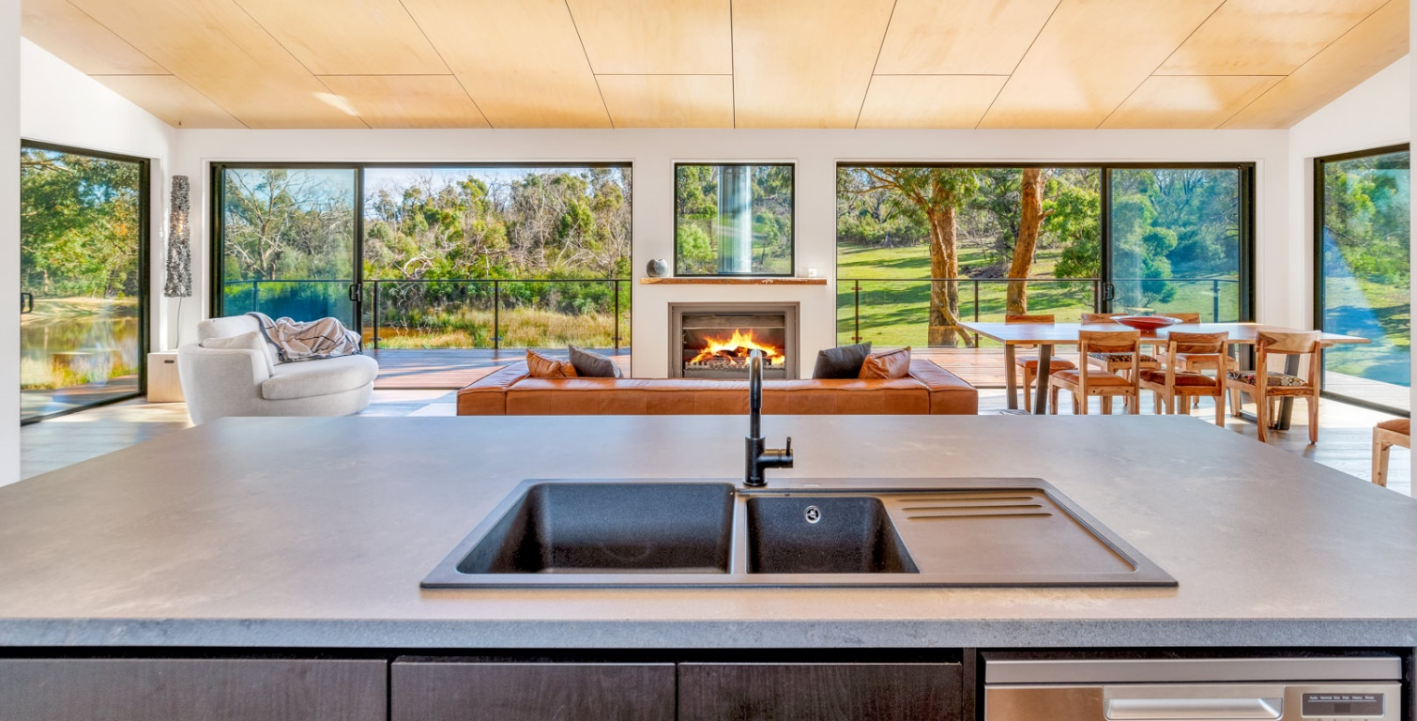

Design Innovation Quality Performance
🏠
TIMBER
DOORS
TIMBER WINDOWS
TIMGUARD
TIMBER SPECIES
ALUMINIUM
WINDOWS
ALUMINIUM
DOORS
ALUMINIUM RANGES
TEXTURA
POWDER COAT
ALUMINIUM
COLOURS
ENERGY RATINGS
ORDER
PROCESS
MYTHS ABOUT CHOOSING TIMBER
100 SERIES VALUE RESIDENTIAL
200 SERIES
IMPROVED PERFORMANCE
300 SERIES
HIGH END ARCHITECTURAL
TECHNICAL SUPPORT
Aluminium Door Range
100 SERIES
200 SERIES
300 SERIES
Sliding Doors
Sliding Doors
Sliding Doors
Stacking Sliding Doors
Stacking Sliding Doors
Stacking Sliding Doors
Bifold Doors
Bifold Doors
Bifold Doors
French Doors
French Doors
French Doors

Slide 12
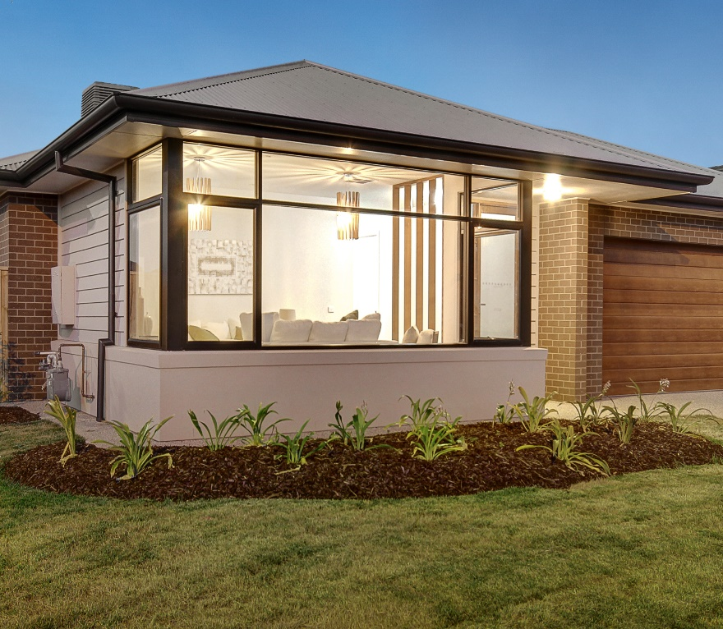

Design Innovation Quality Performance
🏠
TIMBER
DOORS
TIMBER WINDOWS
TIMGUARD
TIMBER SPECIES
ALUMINIUM
WINDOWS
ALUMINIUM
DOORS
ALUMINIUM RANGES
TEXTURA
POWDER COAT
ALUMINIUM
COLOURS
ENERGY RATINGS
ORDER
PROCESS
MYTHS ABOUT CHOOSING TIMBER
100 SERIES VALUE RESIDENTIAL
200 SERIES
IMPROVED PERFORMANCE
300 SERIES
HIGH END ARCHITECTURAL
TECHNICAL SUPPORT
Aluminium Window Range
100 SERIES
200 SERIES
300 SERIES
Sliding Windows
Sliding Windows
Sliding Windows
Awning Windows
Awning Windows
Awning Windows
Double Hung Windows
Bifold Windows
Bifold Windows
Casement Windows
Bifold Windows
Louvre Windows

Slide 13
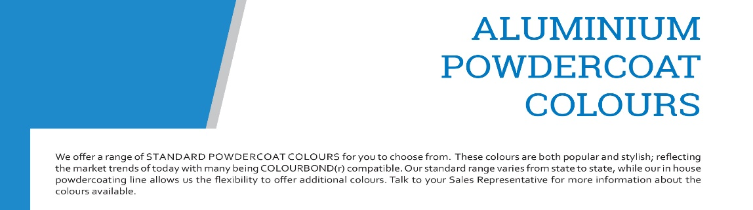
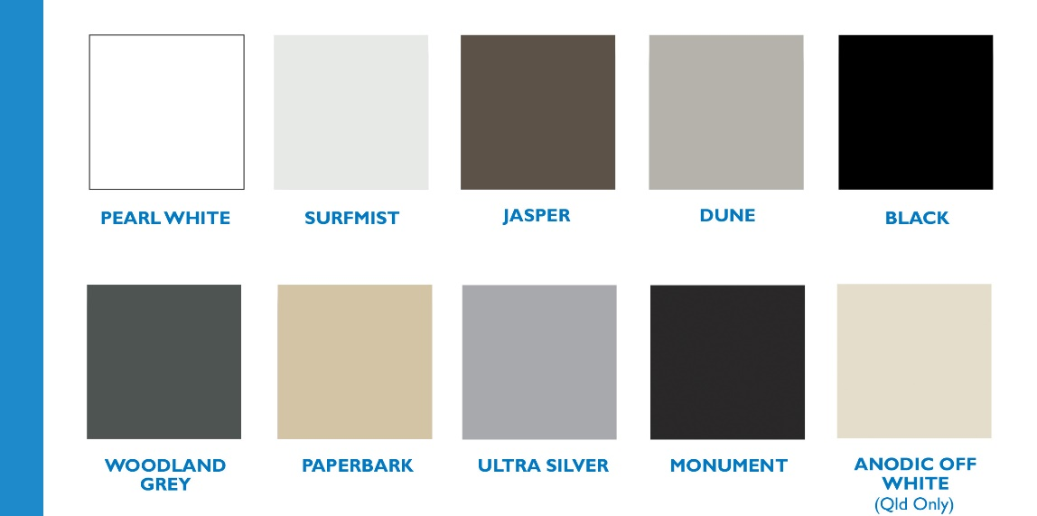

Design Innovation Quality Performance
TIMBER
DOORS
TIMBER WINDOWS
TIMGUARD
TIMBER SPECIES
MYTHS ABOUT CHOOSING TIMBER
ALUMINIUM
WINDOWS
ALUMINIUM
DOORS
ALUMINIUM RANGES
100 SERIES VALUE RESIDENTIAL
200 SERIES
IMPROVED PERFORMANCE
300 SERIES
HIGH END ARCHITECTURAL
TEXTURA
POWDER COAT
ALUMINIUM
COLOURS
ENERGY RATINGS
🏠
ORDER
PROCESS
TECHNICAL SUPPORT

Slide 14
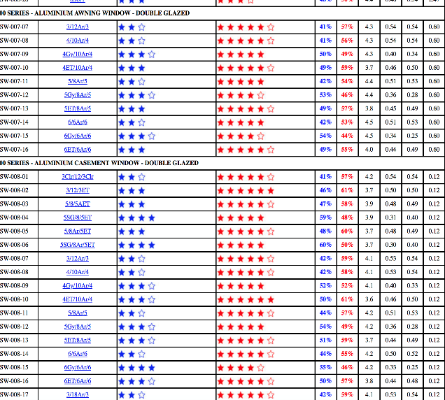
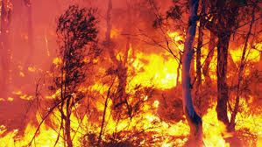
Design Innovation Quality Performance
🏠
TIMBER
DOORS
TIMBER WINDOWS
TIMGUARD
TIMBER SPECIES
ALUMINIUM
WINDOWS
ALUMINIUM
DOORS
ALUMINIUM RANGES
TEXTURA
POWDER COAT
ALUMINIUM
COLOURS
ENERGY RATINGS
ORDER
PROCESS
MYTHS ABOUT CHOOSING TIMBER
100 SERIES VALUE RESIDENTIAL
200 SERIES
IMPROVED PERFORMANCE
300 SERIES
HIGH END ARCHITECTURAL
TECHNICAL SUPPORT
ENERGY RATINGS AND PERFORMANCE
All timber and aluminium products are WERS tested and accredited
Aluminium Products available with U Value of 3.1
Timber Products available with U Value of 1.9
Aluminium Shading Co-efficient Ratings at .73
Timber Shading Co-efficient Ratings at .64
BAL Ratings for aluminium products up to BAL 40
BAL Ratings for timber products up to BAL 29

Slide 15

Design Innovation Quality Performance
🏠
TIMBER
DOORS
TIMBER WINDOWS
TIMGUARD
TIMBER SPECIES
ALUMINIUM
WINDOWS
ALUMINIUM
DOORS
ALUMINIUM RANGES
TEXTURA
POWDER COAT
ALUMINIUM
COLOURS
ENERGY RATINGS
ORDER
PROCESS
MYTHS ABOUT CHOOSING TIMBER
100 SERIES VALUE RESIDENTIAL
200 SERIES
IMPROVED PERFORMANCE
300 SERIES
HIGH END ARCHITECTURAL
TECHNICAL SUPPORT
Qualification Process to Obtain a Quote from Canterbury
Email the Canterbury Account Manager directly.
Floorplan, elevations, window & door schedule, energy report & BAL rating required.
Document any changes required that are not on the plans
Let the Canterbury Account Manager know of the urgency of the quote. Has the job started?
Allow approximately 5 to 7 working days to get a quote back.
Welcome the Canterbury Account Manager to discuss the quote with you.

Slide 16
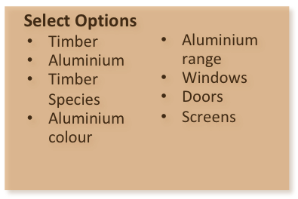

Design Innovation Quality Performance
🏠
TIMBER
DOORS
TIMBER WINDOWS
TIMGUARD
TIMBER SPECIES
ALUMINIUM
WINDOWS
ALUMINIUM
DOORS
ALUMINIUM RANGES
TEXTURA
POWDER COAT
ALUMINIUM
COLOURS
ENERGY RATINGS
ORDER
PROCESS
MYTHS ABOUT CHOOSING TIMBER
100 SERIES VALUE RESIDENTIAL
200 SERIES
IMPROVED PERFORMANCE
300 SERIES
HIGH END ARCHITECTURAL
TECHNICAL SUPPORT
Quote and Order Process
Email or give the building plans to Canterbury Rep
Confirmation of the order
detailing price and delivery date will be provided within 24-48hrs.
TAG member raise an order on Canterbury with signed approval or purchase order
Canterbury Rep will present a quotation for review and approval by the TAG member
Canterbury Rep
LEGEND
TAG member
Order goes into production
Delivery of order to site as per agreed date

Slide 17
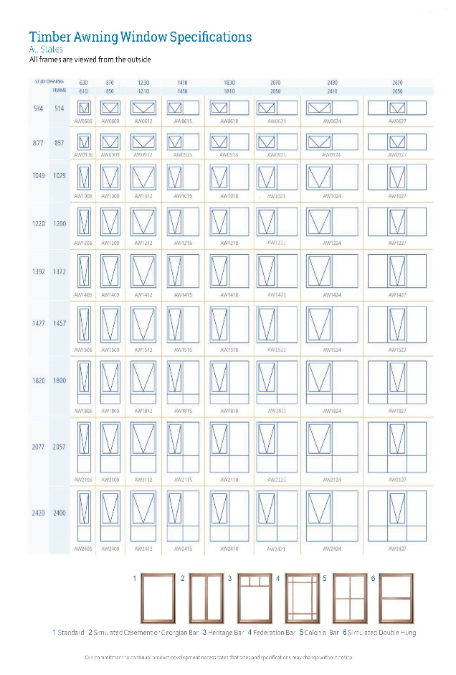
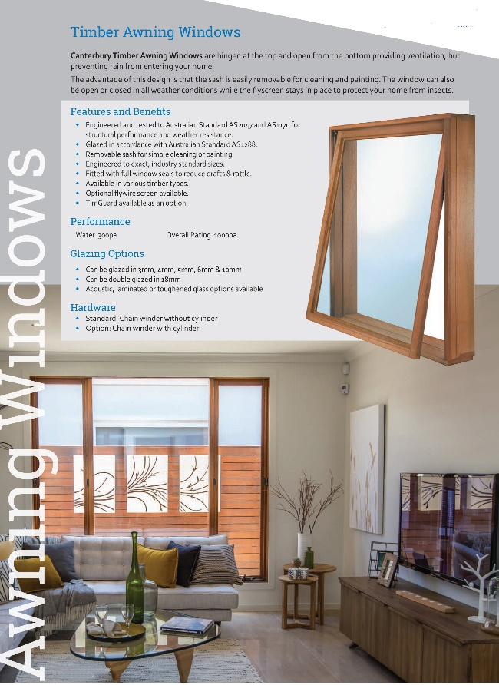
Design Innovation Quality Performance
TIMBER
DOORS
🏠
Timber Awning Window
TIMBER WINDOWS
TIMGUARD
TIMBER SPECIES
MYTHS ABOUT CHOOSING TIMBER
ALUMINIUM
WINDOWS
ALUMINIUM
DOORS
ALUMINIUM RANGES
100 SERIES VALUE RESIDENTIAL
200 SERIES
IMPROVED PERFORMANCE
300 SERIES
HIGH END ARCHITECTURAL
TEXTURA
POWDER COAT
ALUMINIUM
COLOURS
ENERGY RATINGS
ORDER
PROCESS
TECHNICAL SUPPORT

Slide 18
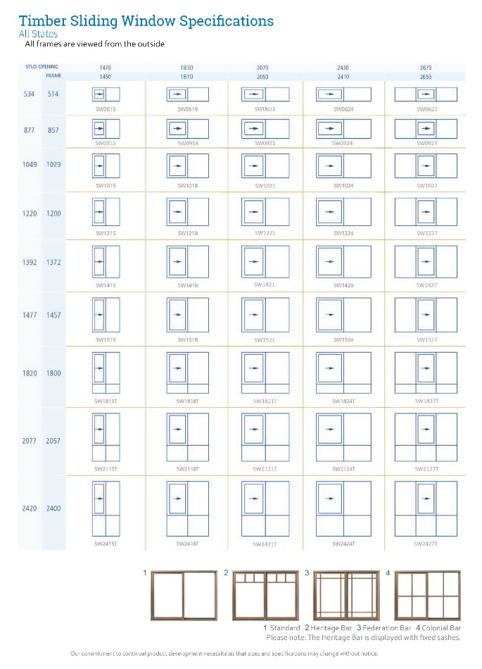
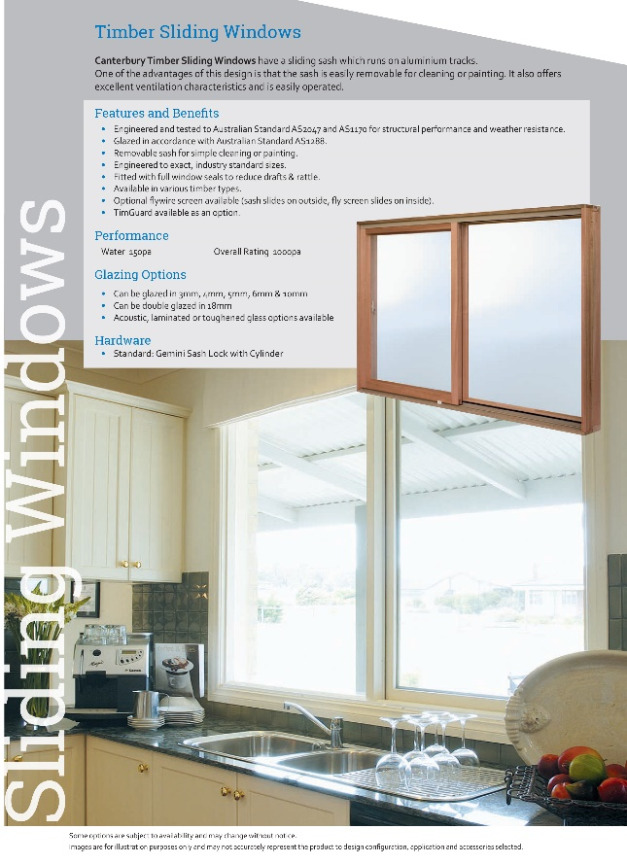
Design Innovation Quality Performance
TIMBER
DOORS
🏠
Timber Sliding Window
TIMBER WINDOWS
TIMGUARD
TIMBER SPECIES
MYTHS ABOUT CHOOSING TIMBER
ALUMINIUM
WINDOWS
ALUMINIUM
DOORS
ALUMINIUM RANGES
100 SERIES VALUE RESIDENTIAL
200 SERIES
IMPROVED PERFORMANCE
300 SERIES
HIGH END ARCHITECTURAL
TEXTURA
POWDER COAT
ALUMINIUM
COLOURS
ENERGY RATINGS
ORDER
PROCESS
TECHNICAL SUPPORT

Slide 19
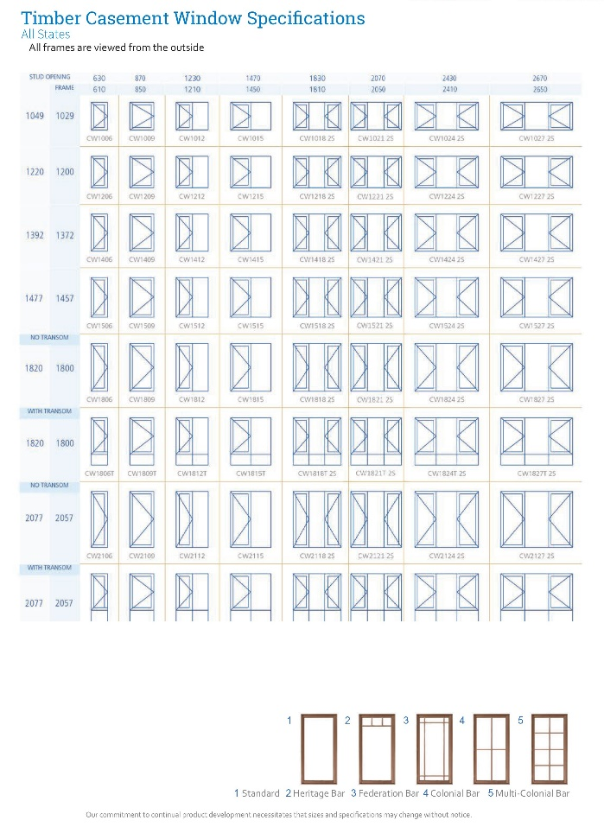
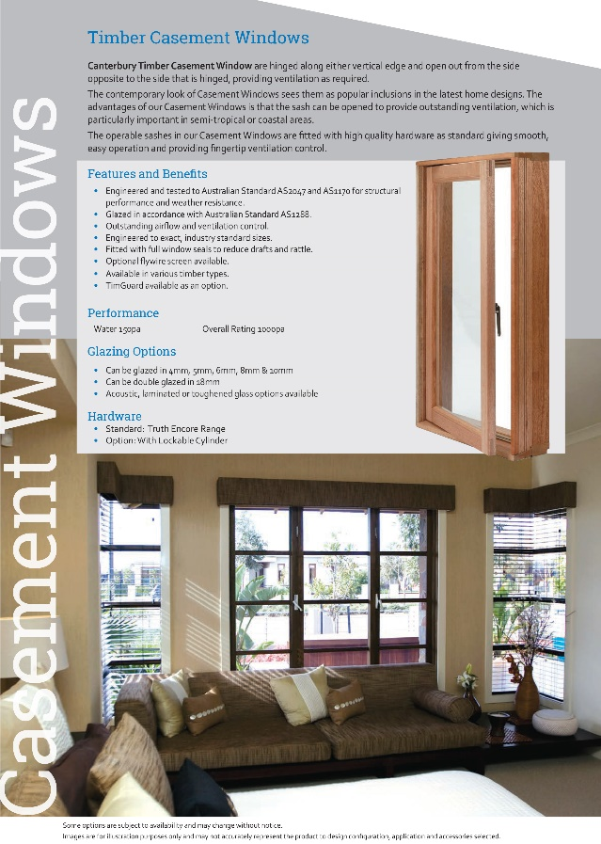
Design Innovation Quality Performance
TIMBER
DOORS
🏠
Timber Casement Window
TIMBER WINDOWS
TIMGUARD
TIMBER SPECIES
MYTHS ABOUT CHOOSING TIMBER
ALUMINIUM
WINDOWS
ALUMINIUM
DOORS
ALUMINIUM RANGES
100 SERIES VALUE RESIDENTIAL
200 SERIES
IMPROVED PERFORMANCE
300 SERIES
HIGH END ARCHITECTURAL
TEXTURA
POWDER COAT
ALUMINIUM
COLOURS
ENERGY RATINGS
ORDER
PROCESS
TECHNICAL SUPPORT

Slide 20
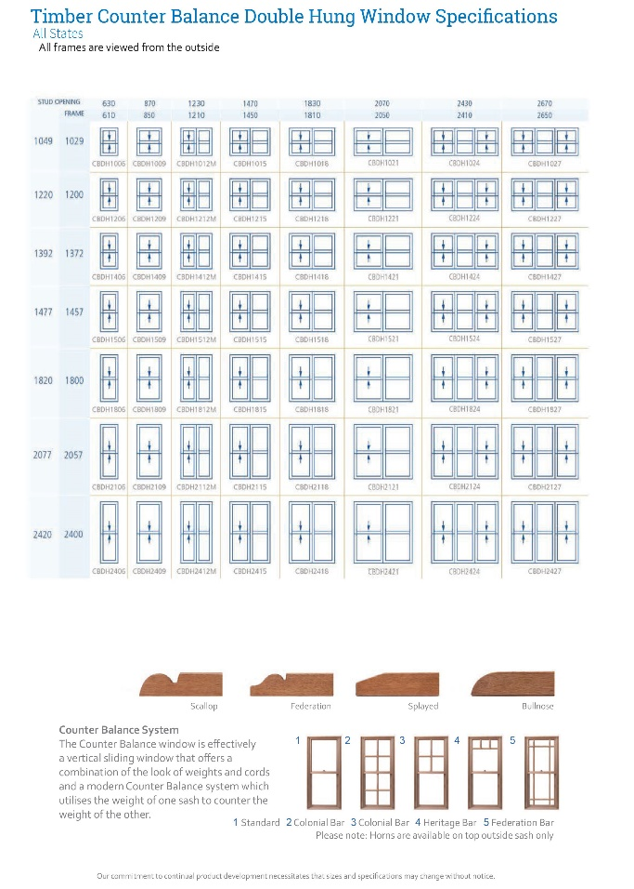

Design Innovation Quality Performance
TIMBER
DOORS
🏠
Timber Double Hung Window
TIMBER WINDOWS
TIMGUARD
TIMBER SPECIES
MYTHS ABOUT CHOOSING TIMBER
ALUMINIUM
WINDOWS
ALUMINIUM
DOORS
ALUMINIUM RANGES
100 SERIES VALUE RESIDENTIAL
200 SERIES
IMPROVED PERFORMANCE
300 SERIES
HIGH END ARCHITECTURAL
TEXTURA
POWDER COAT
ALUMINIUM
COLOURS
ENERGY RATINGS
ORDER
PROCESS
TECHNICAL SUPPORT

Slide 21
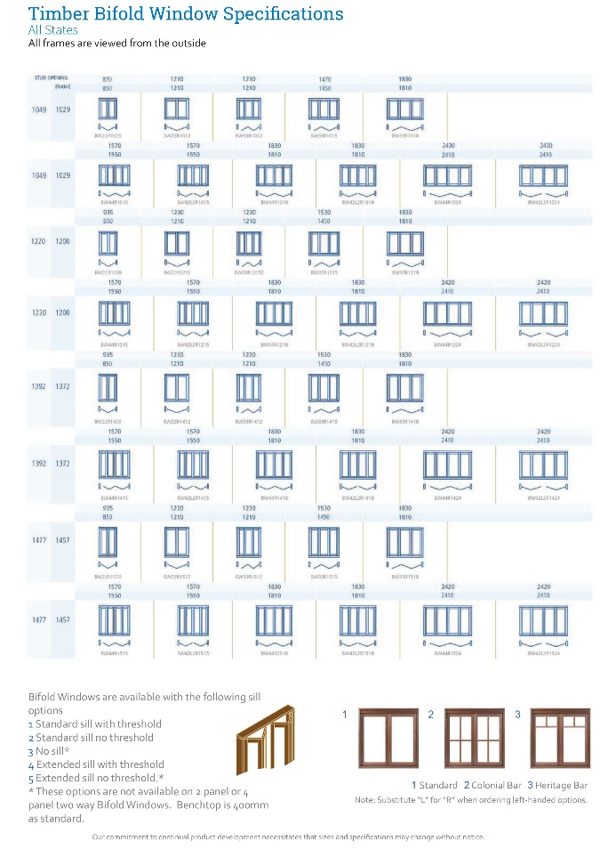
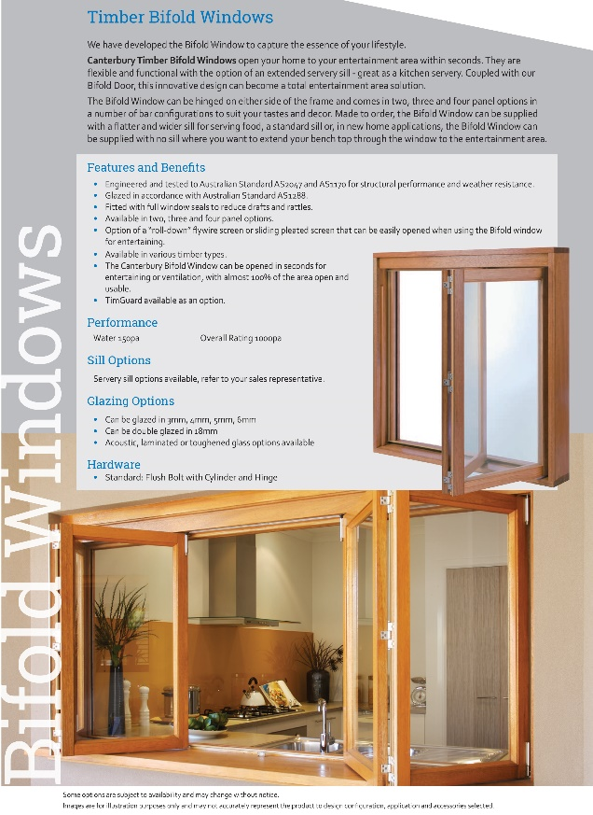

Design Innovation Quality Performance
TIMBER
DOORS
🏠
Timber Bifold Window
TIMBER WINDOWS
TIMGUARD
TIMBER SPECIES
MYTHS ABOUT CHOOSING TIMBER
ALUMINIUM
WINDOWS
ALUMINIUM
DOORS
ALUMINIUM RANGES
100 SERIES VALUE RESIDENTIAL
200 SERIES
IMPROVED PERFORMANCE
300 SERIES
HIGH END ARCHITECTURAL
TEXTURA
POWDER COAT
ALUMINIUM
COLOURS
ENERGY RATINGS
ORDER
PROCESS
TECHNICAL SUPPORT

Slide 22
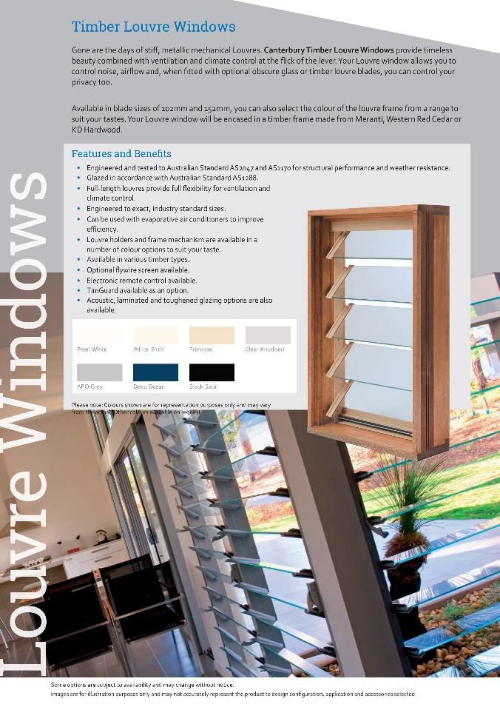
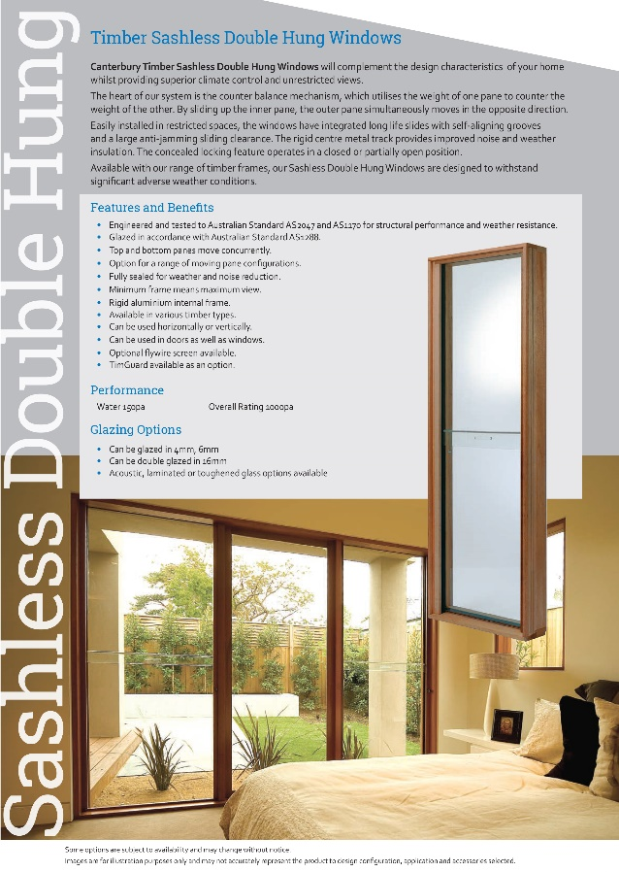
Design Innovation Quality Performance
Timber Louvre Window
TIMBER
DOORS
🏠
Timber Sashless D/Hung Window
TIMBER WINDOWS
TIMGUARD
TIMBER SPECIES
MYTHS ABOUT CHOOSING TIMBER
ALUMINIUM
WINDOWS
ALUMINIUM
DOORS
ALUMINIUM RANGES
100 SERIES VALUE RESIDENTIAL
200 SERIES
IMPROVED PERFORMANCE
300 SERIES
HIGH END ARCHITECTURAL
TEXTURA
POWDER COAT
ALUMINIUM
COLOURS
ENERGY RATINGS
ORDER
PROCESS
TECHNICAL SUPPORT

Slide 23
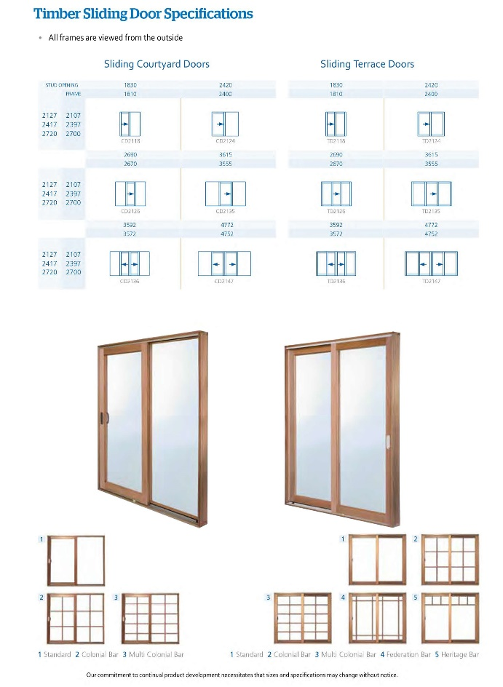
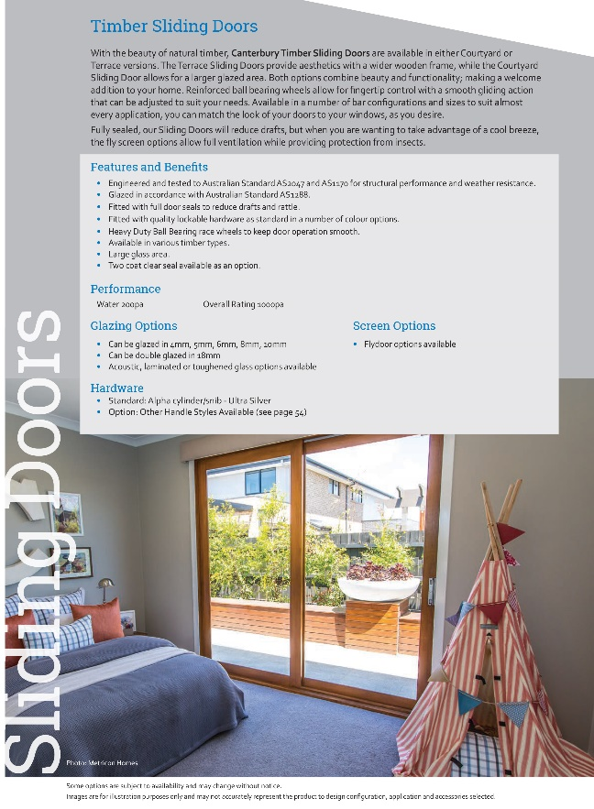
Design Innovation Quality Performance
TIMBER
DOORS
🏠
Timber Sliding Door
TIMBER WINDOWS
TIMGUARD
TIMBER SPECIES
MYTHS ABOUT CHOOSING TIMBER
ALUMINIUM
WINDOWS
ALUMINIUM
DOORS
ALUMINIUM RANGES
100 SERIES VALUE RESIDENTIAL
200 SERIES
IMPROVED PERFORMANCE
300 SERIES
HIGH END ARCHITECTURAL
TEXTURA
POWDER COAT
ALUMINIUM
COLOURS
ENERGY RATINGS
ORDER
PROCESS
TECHNICAL SUPPORT

Slide 24
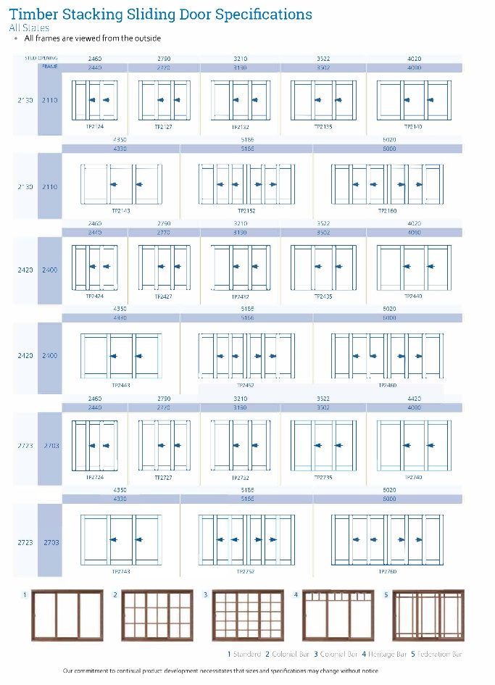
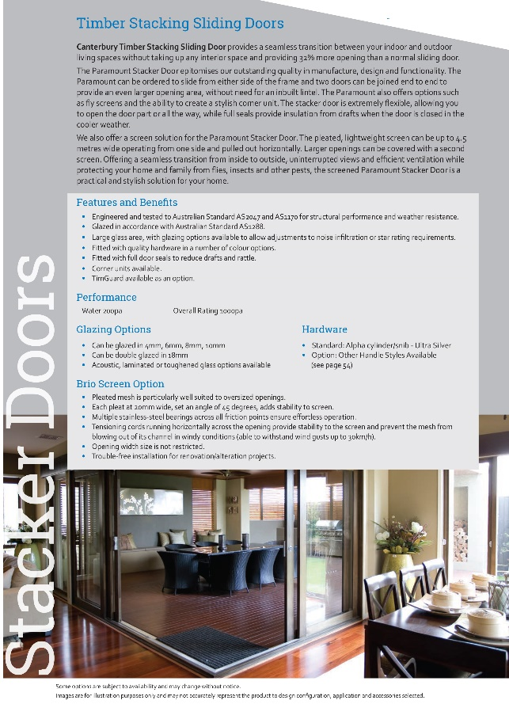
Design Innovation Quality Performance
TIMBER
DOORS
🏠
Timber Stacking Sliding Door
TIMBER WINDOWS
TIMGUARD
TIMBER SPECIES
MYTHS ABOUT CHOOSING TIMBER
ALUMINIUM
WINDOWS
ALUMINIUM
DOORS
ALUMINIUM RANGES
100 SERIES VALUE RESIDENTIAL
200 SERIES
IMPROVED PERFORMANCE
300 SERIES
HIGH END ARCHITECTURAL
TEXTURA
POWDER COAT
ALUMINIUM
COLOURS
ENERGY RATINGS
ORDER
PROCESS
TECHNICAL SUPPORT

Slide 25
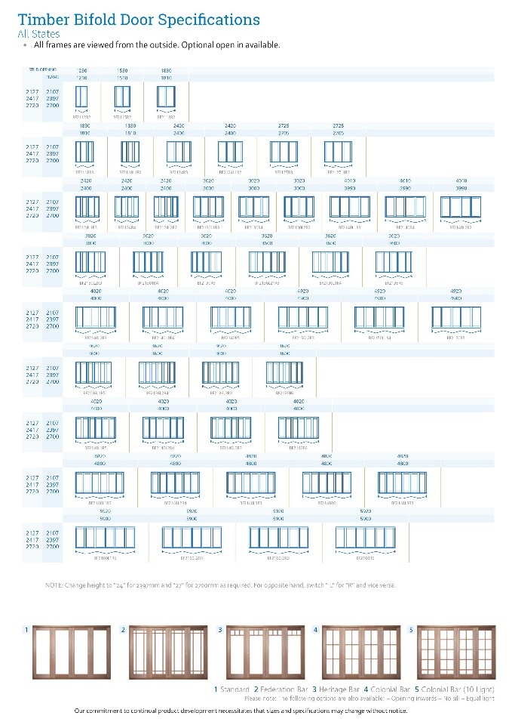
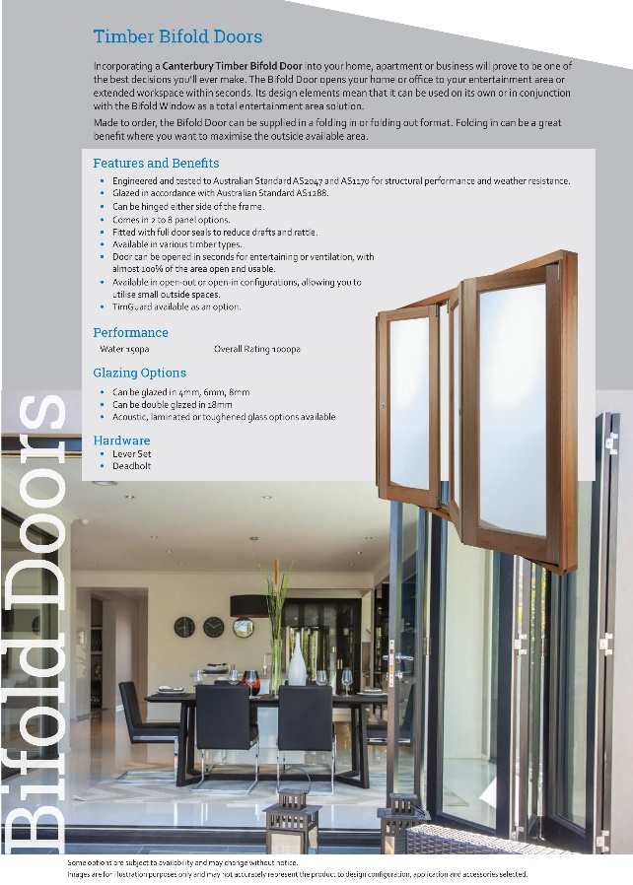
Design Innovation Quality Performance
TIMBER
DOORS
🏠
Timber Bifold Door
TIMBER WINDOWS
TIMGUARD
TIMBER SPECIES
MYTHS ABOUT CHOOSING TIMBER
ALUMINIUM
WINDOWS
ALUMINIUM
DOORS
ALUMINIUM RANGES
100 SERIES VALUE RESIDENTIAL
200 SERIES
IMPROVED PERFORMANCE
300 SERIES
HIGH END ARCHITECTURAL
TEXTURA
POWDER COAT
ALUMINIUM
COLOURS
ENERGY RATINGS
ORDER
PROCESS
TECHNICAL SUPPORT

Slide 26
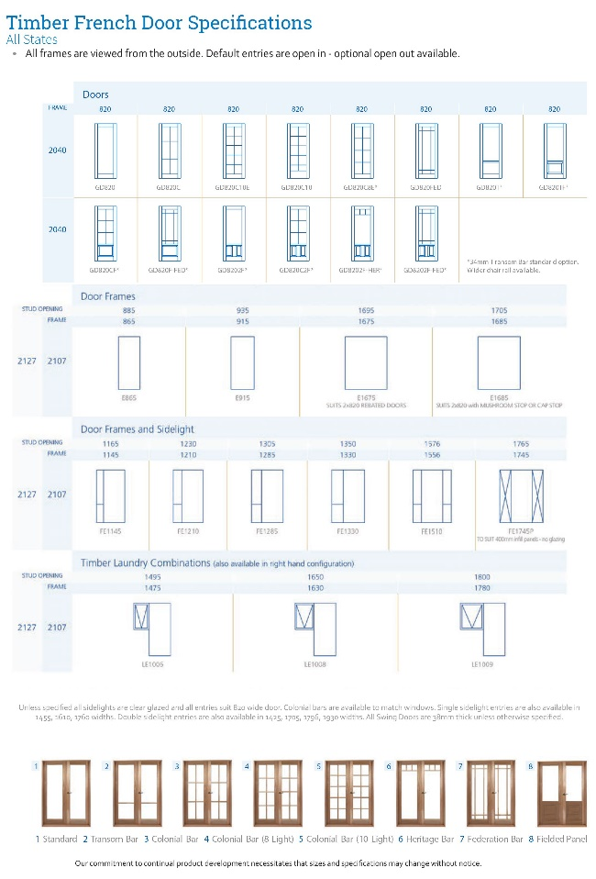
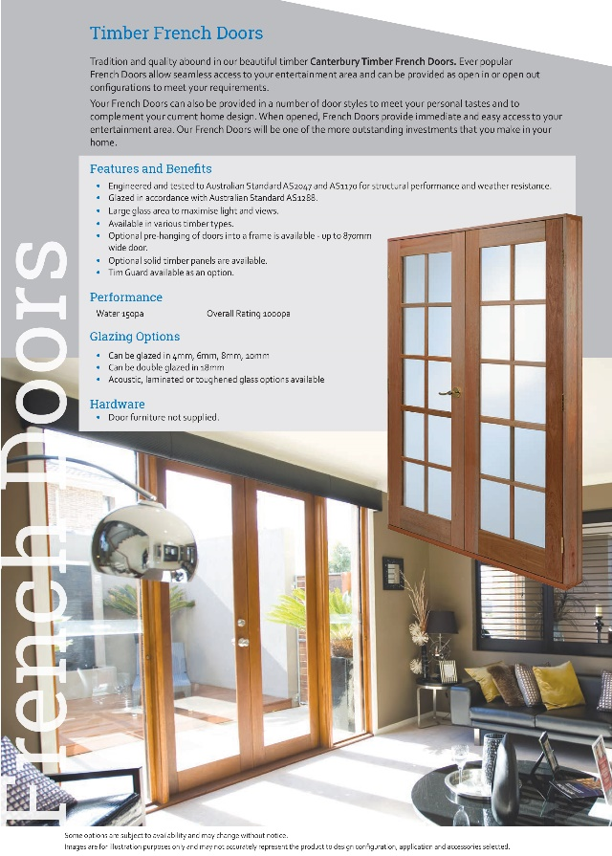
Design Innovation Quality Performance
TIMBER
DOORS
🏠
Timber French Door
TIMBER WINDOWS
TIMGUARD
TIMBER SPECIES
MYTHS ABOUT CHOOSING TIMBER
ALUMINIUM
WINDOWS
ALUMINIUM
DOORS
ALUMINIUM RANGES
100 SERIES VALUE RESIDENTIAL
200 SERIES
IMPROVED PERFORMANCE
300 SERIES
HIGH END ARCHITECTURAL
TEXTURA
POWDER COAT
ALUMINIUM
COLOURS
ENERGY RATINGS
ORDER
PROCESS
TECHNICAL SUPPORT

Slide 27
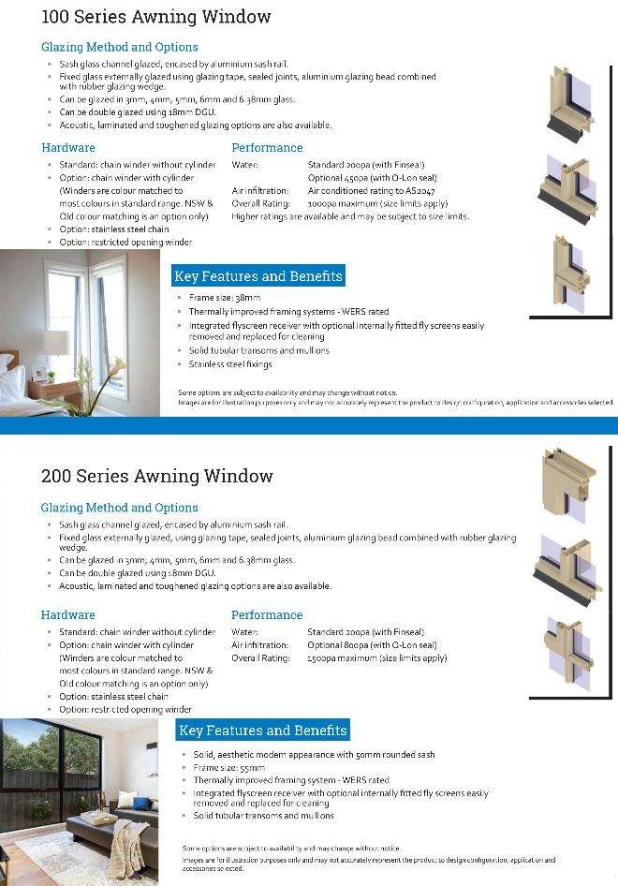
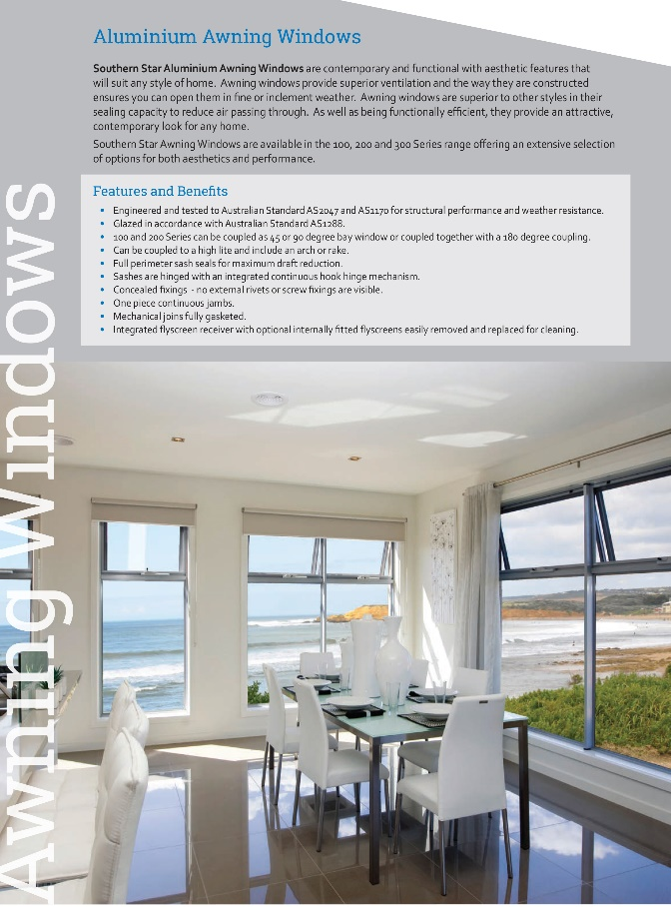
Design Innovation Quality Performance
🏠
Size Specs
TIMBER
DOORS
TIMBER WINDOWS
TIMGUARD
TIMBER SPECIES
MYTHS ABOUT CHOOSING TIMBER
ALUMINIUM
WINDOWS
ALUMINIUM
DOORS
ALUMINIUM RANGES
Size Specs
100 SERIES VALUE RESIDENTIAL
200 SERIES
IMPROVED PERFORMANCE
300 SERIES
HIGH END ARCHITECTURAL
TEXTURA
POWDER COAT
ALUMINIUM
COLOURS
ENERGY RATINGS
ORDER
PROCESS
TECHNICAL SUPPORT

Slide 28
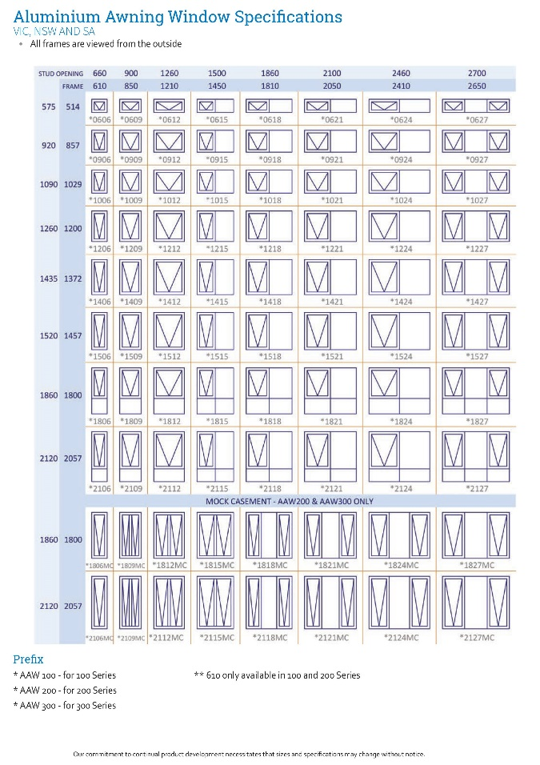
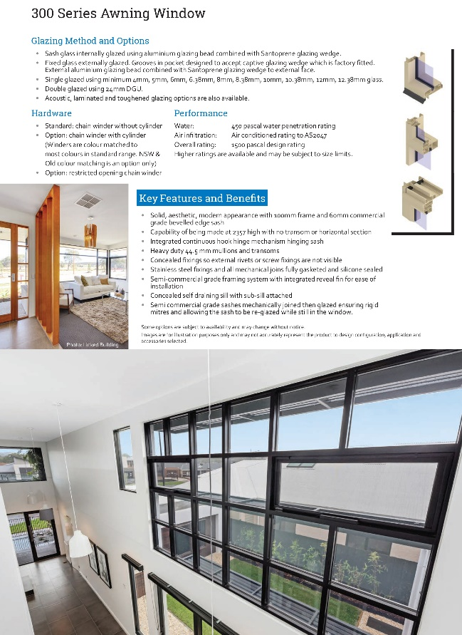
Design Innovation Quality Performance
All ranges
TIMBER
DOORS
🏠
Size Specs
TIMBER WINDOWS
TIMGUARD
TIMBER SPECIES
MYTHS ABOUT CHOOSING TIMBER
ALUMINIUM
WINDOWS
ALUMINIUM
DOORS
ALUMINIUM RANGES
100 SERIES VALUE RESIDENTIAL
200 SERIES
IMPROVED PERFORMANCE
300 SERIES
HIGH END ARCHITECTURAL
TEXTURA
POWDER COAT
ALUMINIUM
COLOURS
ENERGY RATINGS
ORDER
PROCESS
TECHNICAL SUPPORT

Slide 29
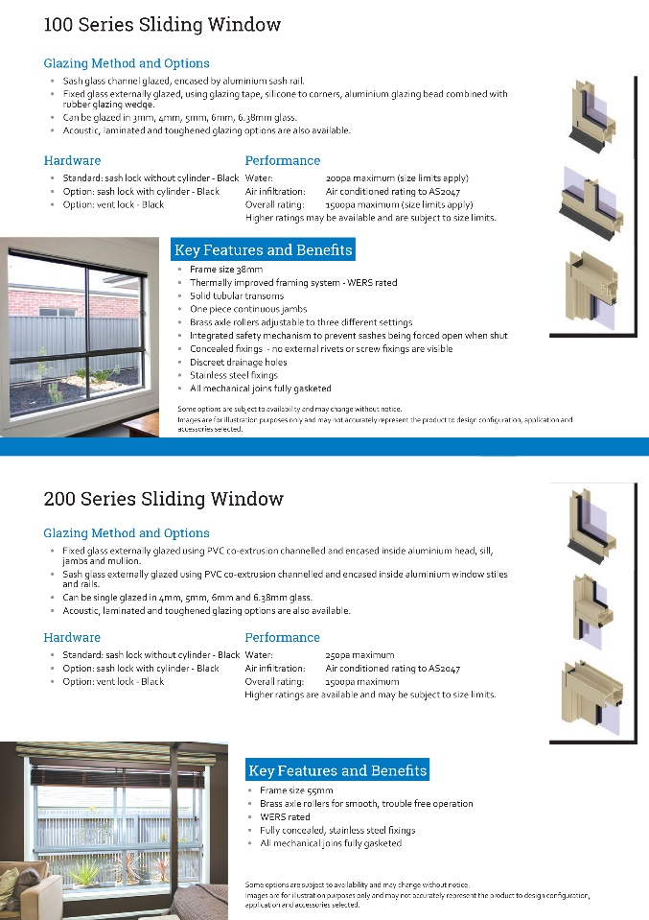
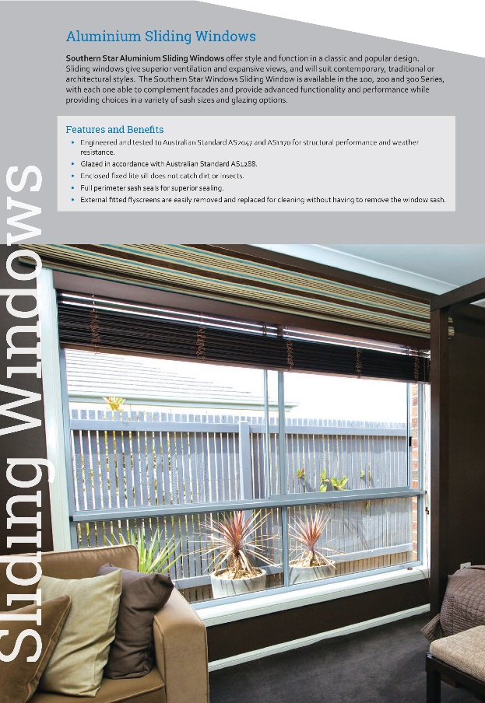
Design Innovation Quality Performance
Size Specs
TIMBER
DOORS
🏠
TIMBER WINDOWS
TIMGUARD
TIMBER SPECIES
MYTHS ABOUT CHOOSING TIMBER
ALUMINIUM
WINDOWS
ALUMINIUM
DOORS
ALUMINIUM RANGES
Size Specs
100 SERIES VALUE RESIDENTIAL
200 SERIES
IMPROVED PERFORMANCE
300 SERIES
HIGH END ARCHITECTURAL
TEXTURA
POWDER COAT
ALUMINIUM
COLOURS
ENERGY RATINGS
ORDER
PROCESS
TECHNICAL SUPPORT

Slide 30
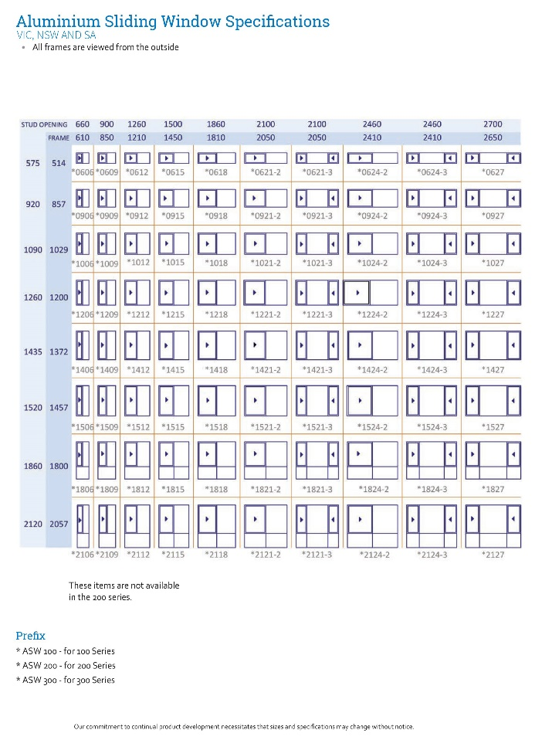
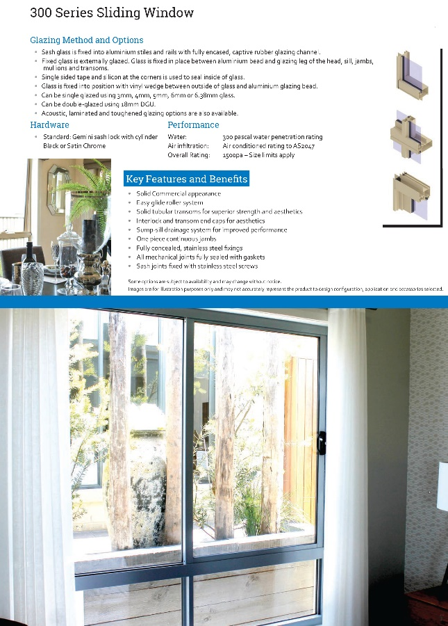
Design Innovation Quality Performance
All ranges
TIMBER
DOORS
🏠
Size Specs
TIMBER WINDOWS
TIMGUARD
TIMBER SPECIES
MYTHS ABOUT CHOOSING TIMBER
ALUMINIUM
WINDOWS
ALUMINIUM
DOORS
ALUMINIUM RANGES
100 SERIES VALUE RESIDENTIAL
200 SERIES
IMPROVED PERFORMANCE
300 SERIES
HIGH END ARCHITECTURAL
TEXTURA
POWDER COAT
ALUMINIUM
COLOURS
ENERGY RATINGS
ORDER
PROCESS
TECHNICAL SUPPORT

Slide 31
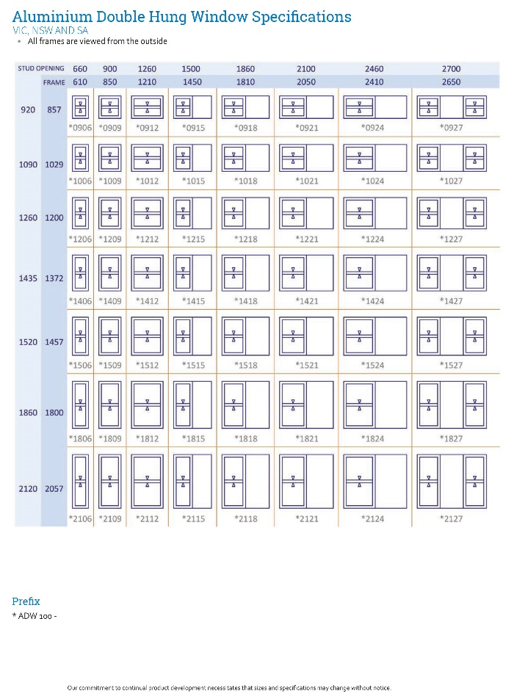
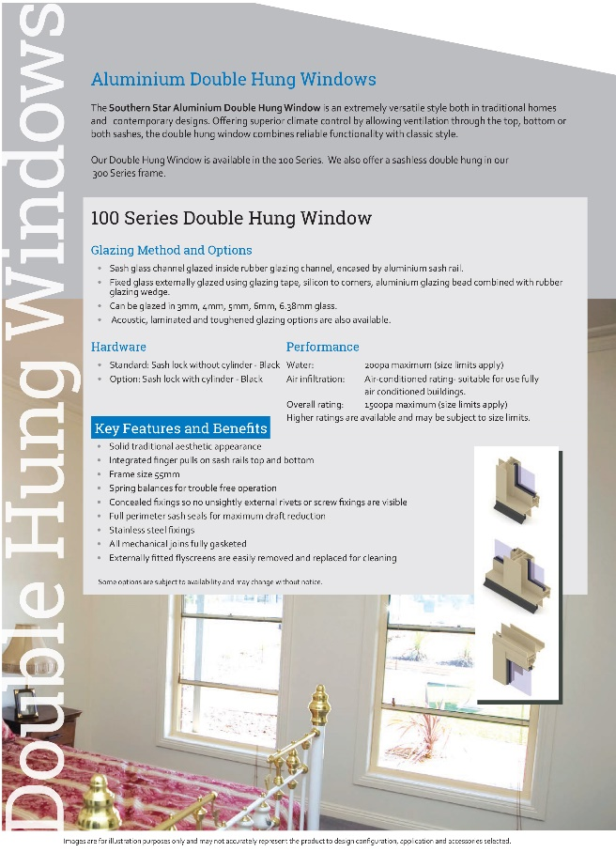

Design Innovation Quality Performance
TIMBER
DOORS
🏠
TIMBER WINDOWS
TIMGUARD
TIMBER SPECIES
MYTHS ABOUT CHOOSING TIMBER
ALUMINIUM
WINDOWS
ALUMINIUM
DOORS
ALUMINIUM RANGES
100 SERIES VALUE RESIDENTIAL
200 SERIES
IMPROVED PERFORMANCE
300 SERIES
HIGH END ARCHITECTURAL
TEXTURA
POWDER COAT
ALUMINIUM
COLOURS
ENERGY RATINGS
ORDER
PROCESS
TECHNICAL SUPPORT

Slide 32
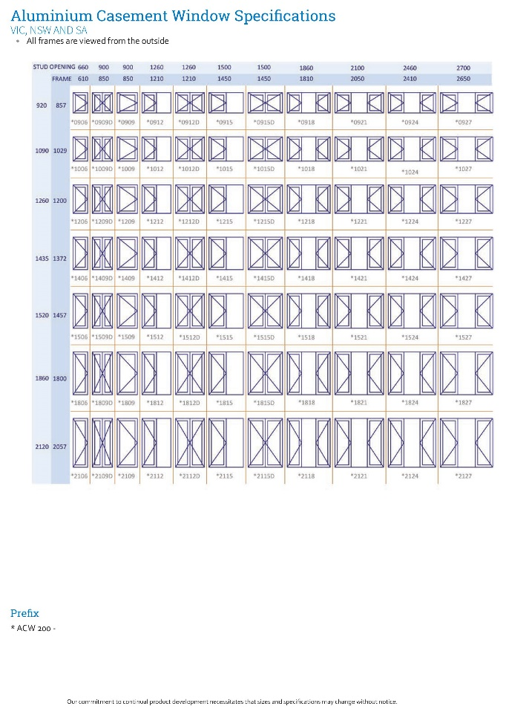
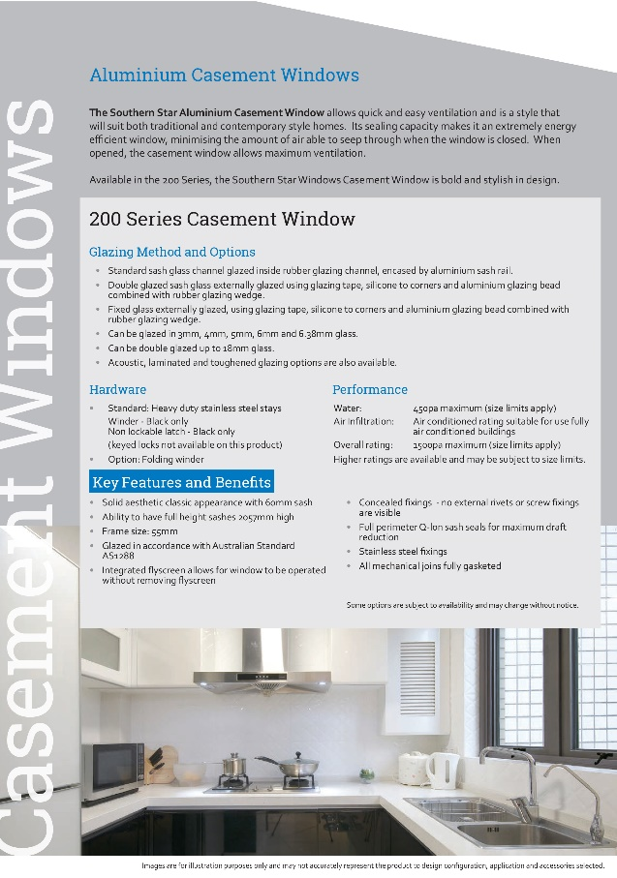

Design Innovation Quality Performance
TIMBER
DOORS
🏠
TIMBER WINDOWS
TIMGUARD
TIMBER SPECIES
MYTHS ABOUT CHOOSING TIMBER
ALUMINIUM
WINDOWS
ALUMINIUM
DOORS
ALUMINIUM RANGES
100 SERIES VALUE RESIDENTIAL
200 SERIES
IMPROVED PERFORMANCE
300 SERIES
HIGH END ARCHITECTURAL
TEXTURA
POWDER COAT
ALUMINIUM
COLOURS
ENERGY RATINGS
ORDER
PROCESS
TECHNICAL SUPPORT

Slide 33
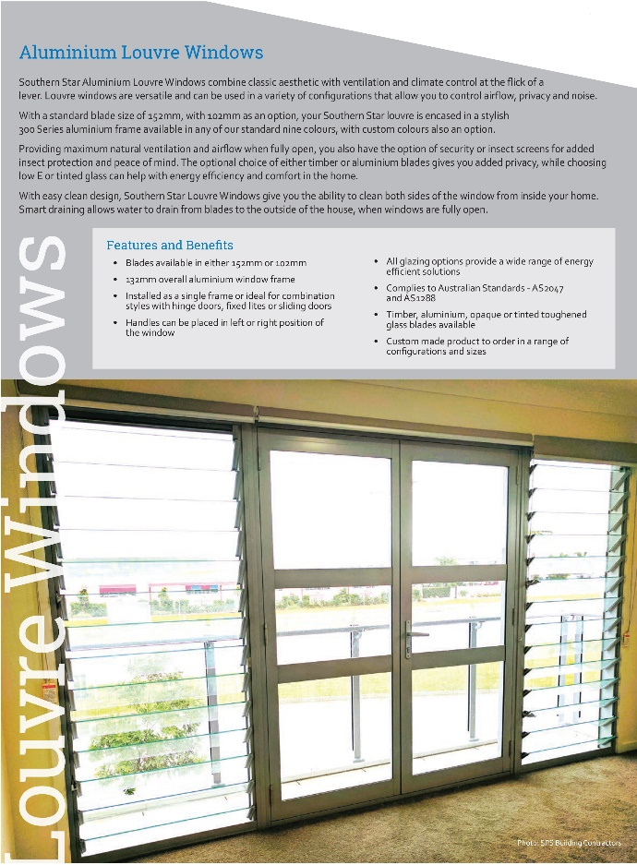

Design Innovation Quality Performance
TIMBER
DOORS
🏠
TIMBER WINDOWS
TIMGUARD
TIMBER SPECIES
MYTHS ABOUT CHOOSING TIMBER
ALUMINIUM
WINDOWS
ALUMINIUM
DOORS
ALUMINIUM RANGES
100 SERIES VALUE RESIDENTIAL
200 SERIES
IMPROVED PERFORMANCE
300 SERIES
HIGH END ARCHITECTURAL
TEXTURA
POWDER COAT
ALUMINIUM
COLOURS
ENERGY RATINGS
ORDER
PROCESS

Slide 34


Design Innovation Quality Performance
Size Specs
TIMBER
DOORS
🏠
TIMBER WINDOWS
TIMGUARD
TIMBER SPECIES
MYTHS ABOUT CHOOSING TIMBER
ALUMINIUM
WINDOWS
ALUMINIUM
DOORS
ALUMINIUM RANGES
Size Specs
100 SERIES VALUE RESIDENTIAL
200 SERIES
IMPROVED PERFORMANCE
300 SERIES
HIGH END ARCHITECTURAL
TEXTURA
POWDER COAT
ALUMINIUM
COLOURS
ENERGY RATINGS
ORDER
PROCESS
TECHNICAL SUPPORT

Slide 35


Design Innovation Quality Performance
TIMBER
DOORS
🏠
TIMBER WINDOWS
TIMGUARD
TIMBER SPECIES
MYTHS ABOUT CHOOSING TIMBER
ALUMINIUM
WINDOWS
ALUMINIUM
DOORS
ALUMINIUM RANGES
100 SERIES VALUE RESIDENTIAL
200 SERIES
IMPROVED PERFORMANCE
300 SERIES
HIGH END ARCHITECTURAL
TEXTURA
POWDER COAT
ALUMINIUM
COLOURS
ENERGY RATINGS
ORDER
PROCESS
TECHNICAL SUPPORT

Slide 36


Design Innovation Quality Performance
TIMBER
DOORS
🏠
TIMBER WINDOWS
TIMGUARD
TIMBER SPECIES
MYTHS ABOUT CHOOSING TIMBER
ALUMINIUM
WINDOWS
ALUMINIUM
DOORS
ALUMINIUM RANGES
100 SERIES VALUE RESIDENTIAL
200 SERIES
IMPROVED PERFORMANCE
300 SERIES
HIGH END ARCHITECTURAL
TEXTURA
POWDER COAT
ALUMINIUM
COLOURS
ENERGY RATINGS
ORDER
PROCESS
TECHNICAL SUPPORT

Slide 37


Design Innovation Quality Performance
Size Specs
TIMBER
DOORS
🏠
TIMBER WINDOWS
TIMGUARD
TIMBER SPECIES
MYTHS ABOUT CHOOSING TIMBER
ALUMINIUM
WINDOWS
ALUMINIUM
DOORS
ALUMINIUM RANGES
Size Specs
100 SERIES VALUE RESIDENTIAL
200 SERIES
IMPROVED PERFORMANCE
300 SERIES
HIGH END ARCHITECTURAL
TEXTURA
POWDER COAT
ALUMINIUM
COLOURS
ENERGY RATINGS
ORDER
PROCESS
TECHNICAL SUPPORT

Slide 38


Design Innovation Quality Performance
All ranges
TIMBER
DOORS
🏠
TIMBER WINDOWS
TIMGUARD
TIMBER SPECIES
MYTHS ABOUT CHOOSING TIMBER
ALUMINIUM
WINDOWS
ALUMINIUM
DOORS
ALUMINIUM RANGES
100 SERIES VALUE RESIDENTIAL
200 SERIES
IMPROVED PERFORMANCE
300 SERIES
HIGH END ARCHITECTURAL
TEXTURA
POWDER COAT
ALUMINIUM
COLOURS
ENERGY RATINGS
ORDER
PROCESS
TECHNICAL SUPPORT

Slide 39



Design Innovation Quality Performance
Size Specs
TIMBER
DOORS
🏠
TIMBER WINDOWS
TIMGUARD
TIMBER SPECIES
MYTHS ABOUT CHOOSING TIMBER
ALUMINIUM
WINDOWS
ALUMINIUM
DOORS
ALUMINIUM RANGES
Size Specs
100 SERIES VALUE RESIDENTIAL
200 SERIES
IMPROVED PERFORMANCE
300 SERIES
HIGH END ARCHITECTURAL
TEXTURA
POWDER COAT
ALUMINIUM
COLOURS
ENERGY RATINGS
ORDER
PROCESS
TECHNICAL SUPPORT

Slide 40


Design Innovation Quality Performance
All ranges
TIMBER
DOORS
🏠
TIMBER WINDOWS
TIMGUARD
TIMBER SPECIES
MYTHS ABOUT CHOOSING TIMBER
ALUMINIUM
WINDOWS
ALUMINIUM
DOORS
ALUMINIUM RANGES
100 SERIES VALUE RESIDENTIAL
200 SERIES
IMPROVED PERFORMANCE
300 SERIES
HIGH END ARCHITECTURAL
TEXTURA
POWDER COAT
ALUMINIUM
COLOURS
ENERGY RATINGS
ORDER
PROCESS
TECHNICAL SUPPORT

Slide 41


Design Innovation Quality Performance
🏠
TIMBER
DOORS
TIMBER WINDOWS
TIMGUARD
TIMBER SPECIES
ALUMINIUM
WINDOWS
ALUMINIUM
DOORS
ALUMINIUM RANGES
TEXTURA
POWDER COAT
ALUMINIUM
COLOURS
ENERGY RATINGS
ORDER
PROCESS
MYTHS ABOUT CHOOSING TIMBER
100 SERIES VALUE RESIDENTIAL
200 SERIES
IMPROVED PERFORMANCE
300 SERIES
HIGH END ARCHITECTURAL
TECHNICAL SUPPORT
Canterbury Windows & Doors Victorian Contacts
State Sales Manager – Brett Hurren 0421 094 540 brett.hurren@canterburywindows.com.au
North A/C Mgr – Matt Millar 0421 094 571 matt.millar@canterburywindows.com.au
West A/C Mgr – Mike Bujak 0421 094 534 mike.bujak@canterburywindows.com.au
East A/C Mgr – Ben Lister 0421 094 572 ben.lister@canterburywindows.com.au
South East A/C Mgr – Troy Knox 0420 962 967 troy.knox@canterburywindows.com.au
South A/C Mgr - Russell Wadsworth 0421 094 541 russell.wadsworth@canterburywindows.com.au

